Slide 1
Hexagonal Architecture

Slide 2
Who am I?
Kevin Sels
Telenet since january
Selfcare
Modernisation -> hexagonal
Axxes since 2007
Java backend
Architecture
Sports
Cycling
Triathlon

Slide 3
Disclaimer: Hexagonal ≈ Ports & Adapters ≈ Clean architecture

Slide 4
Questions?
Feel free to interrupt

Slide 5
What is Hexagonal Architecture

Slide 6
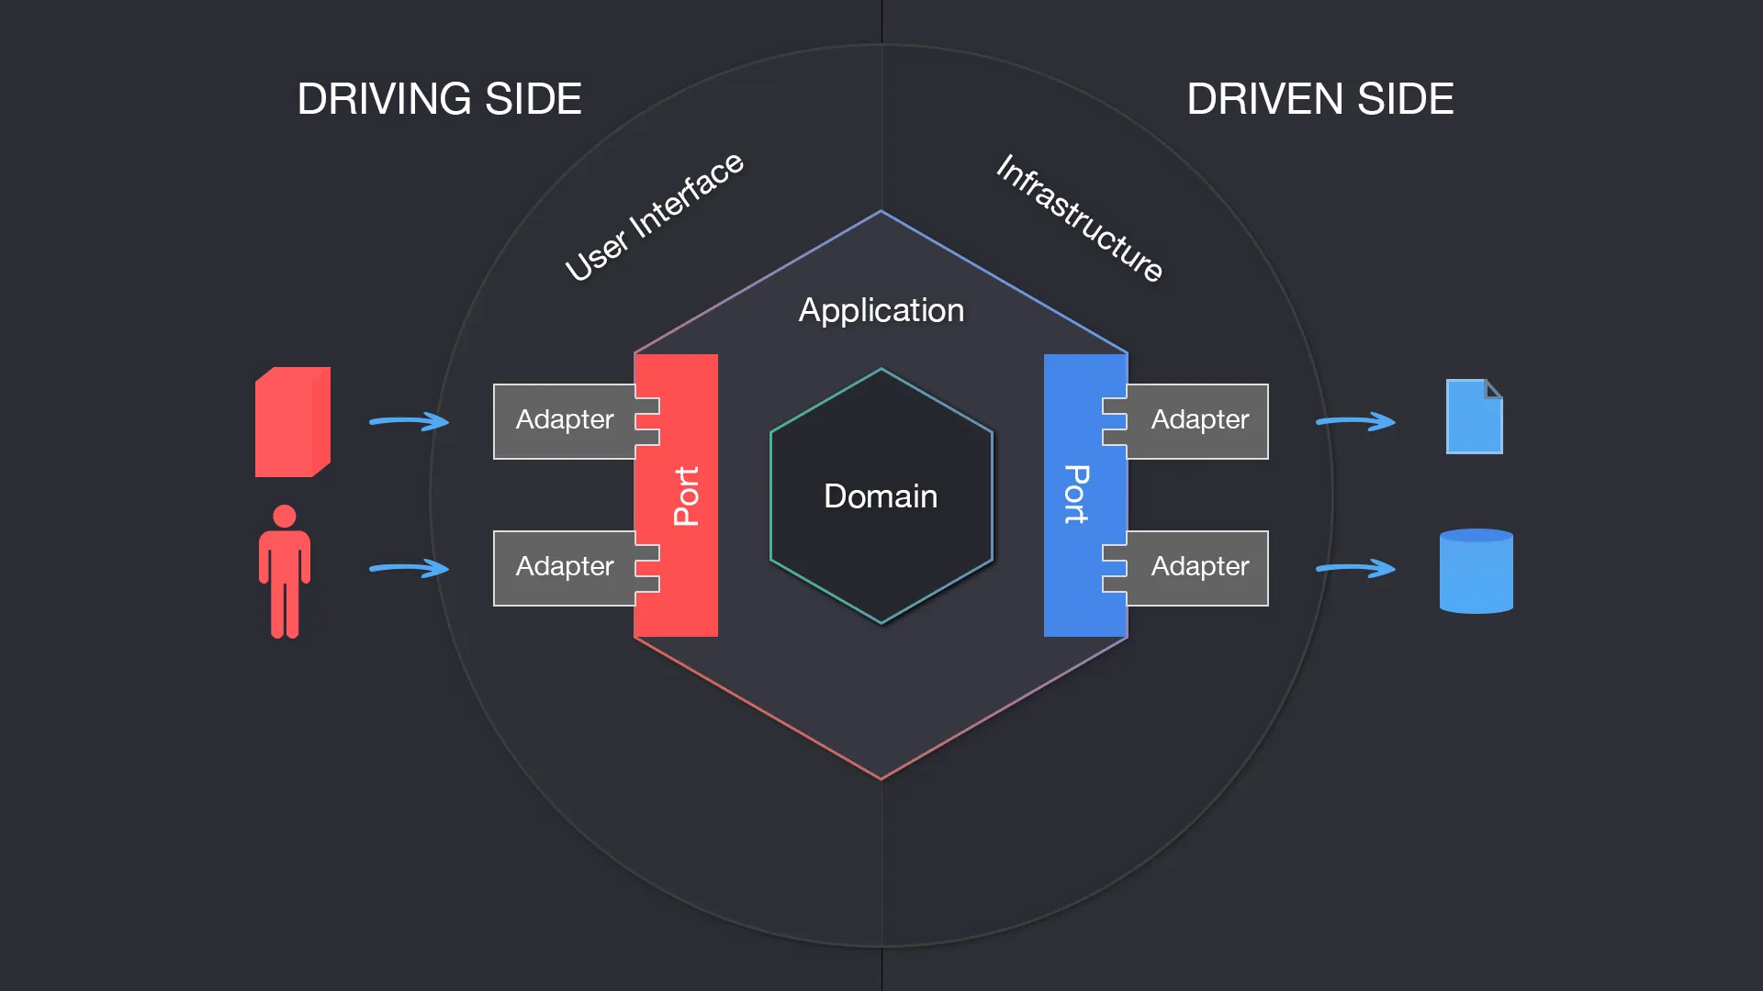

Slide 7
Components
Domain
Domain logic
DDD
Ports
Inbound & Outbound Interfaces of Domain
Inbound -> use cases
Outbound -> external dependencies
Adapters
Implementations of Ports

Slide 8
Domain-centric architecture
Domain doesn’t have dependencies
Implementations & integrations are handled by DI
-> Focus on domain & core logic
-> Cleaner dependencies
-> Allows for evolution with the system’s needs

Slide 9
Reading vs writing code
More time spent
Harder to do
Other developer’s code
Your own code
Risk when misunderstanding:
Regression
Time lost
Written once, read multiple times
=> Optimise for readability

Slide 10
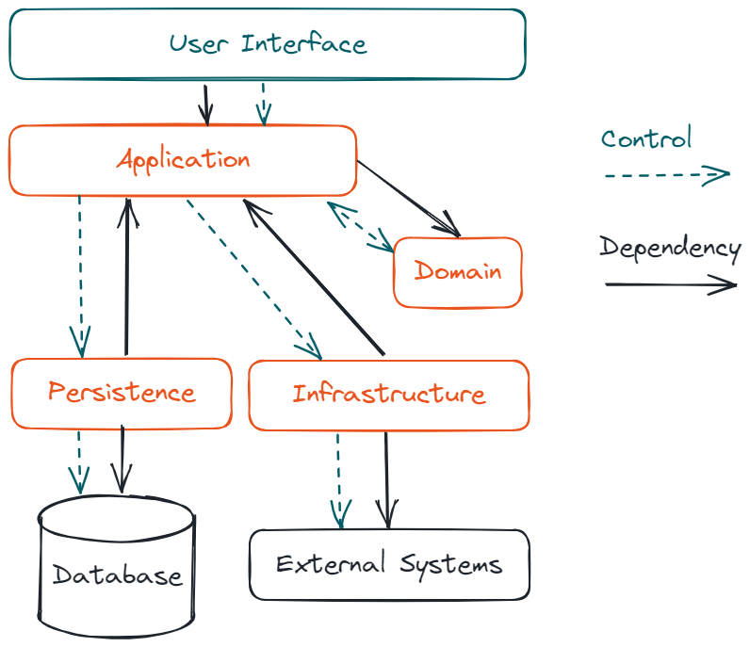
Structured Dependencies

Slide 11
SOLID
Single Responsibility
Open/Closed
Liskov Substitution
Interface Segregation
Dependency Inversion

Slide 12
Structure

Slide 13
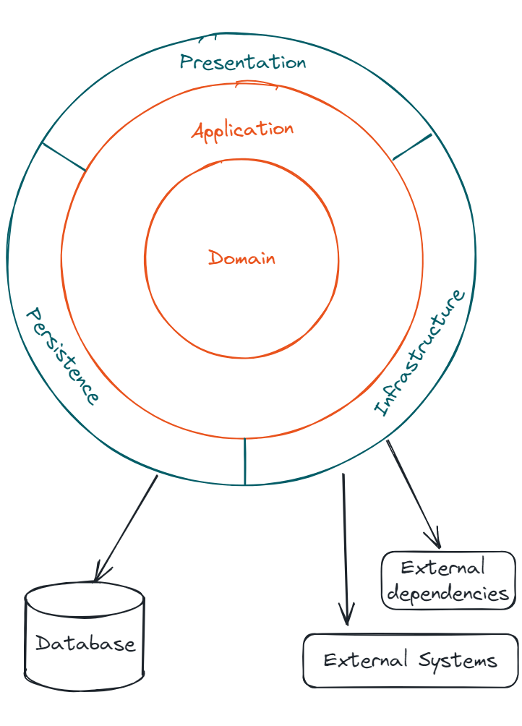
Domain
DDD
Domain Logic
Entities
Aggregates
Value Types
Ubiquitous language
Code in the language of the user
Free of frameworks

Slide 14
Application
Use cases
Contracts
Application services
Persistence
Infrastructure
Free of frameworks

Slide 15
Outbound Adapters
Persistence implementations
Infrastructure implementations
Service proxies
Bus/queue integrations

Slide 16
Inbound Adapters
Translation between
Application
User interface
Api contract
…
Never expose the domain

Slide 17
‘Bootstrap module’
Executable module
DI wiring

Slide 18
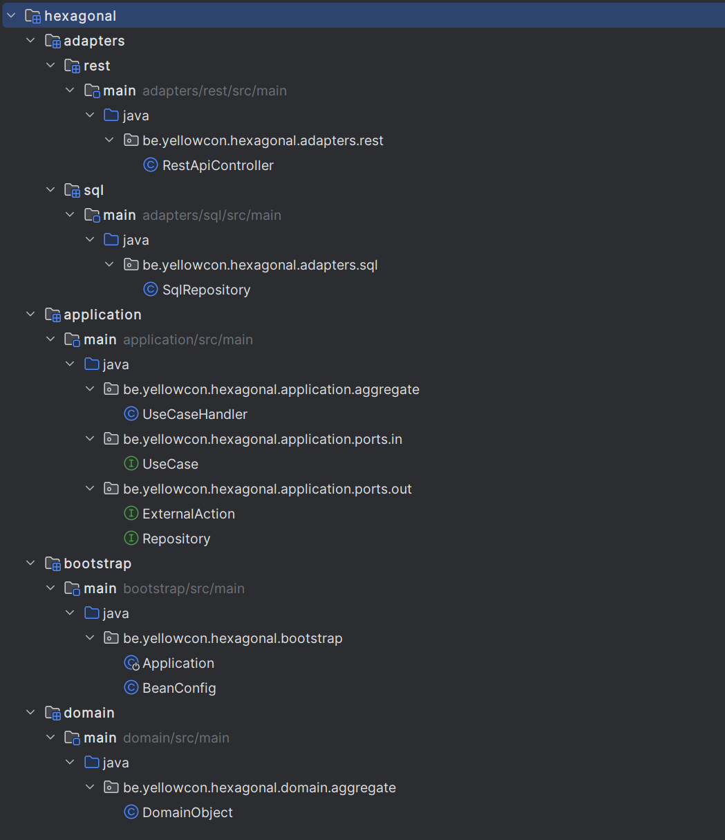
Example

Slide 19
Coding Time

Slide 20
Triathlon registration
Context
Triathlon registration system
Exposes REST api
Licence
Check licence
Register single race licence
Coding time

Slide 21
Domain
Build entities & value types
Build use case handlers that
Consume the domain
Handle the logic for a command
Consume abstractions for dependencies
Define abstractions
Storage (repositories)
External systems (api calls, …)
Validate the behaviour with tests

Slide 22
2. Adapters
Create the rest api
Build an implementation for storage
Hashmap?
Build (mock) implementations for external systems
Console output?
Create external model

Slide 23
3. Tie it all together
Create a bootstrap project
Wire up the dependencies
???
Profit

Slide 24
4. Play around
Consider changing some logic
External contract change
Update business logic
Change external supplier
…
Where is change needed?

Slide 25

https://github.com/selske/yellowcon2024

